Slide 1

Sports Marketing Final Project
Brian BOzzer

Slide 2
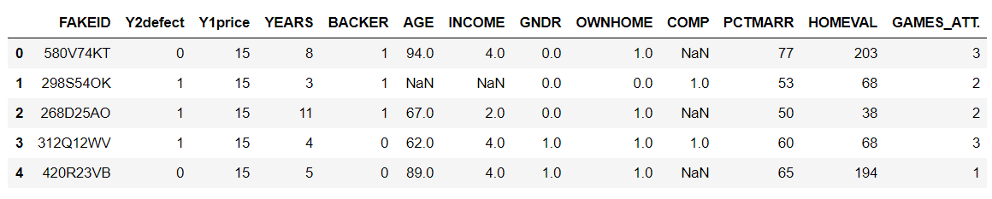
Data Cleaning
For Data Cleaning I first dropped some columns that had a lot of missing values
these were child and sport. I then combined all of the games attended into a total games attended column. After this I filled the missing values in the age and income values with the mean value of the column and the missing values in the comp column with zeros.

Slide 3
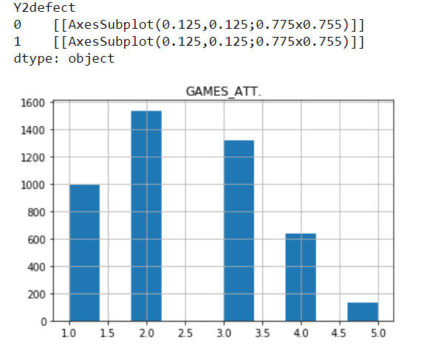
Data visualization
For Data visualization I first started off with some basic histograms to try to get a general idea about trends. For example in this histogram it shows the people who didn’t return grouped by games attended.

Slide 4
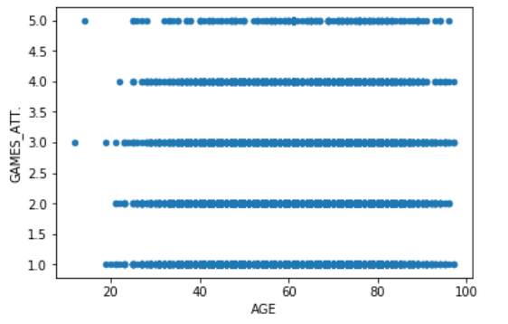
Data Visualization
I then tried to find some trends between variables for instance here it shows Age compared to Games attended. I was trying to get an idea of what kinds of people were going to the games.

Slide 5
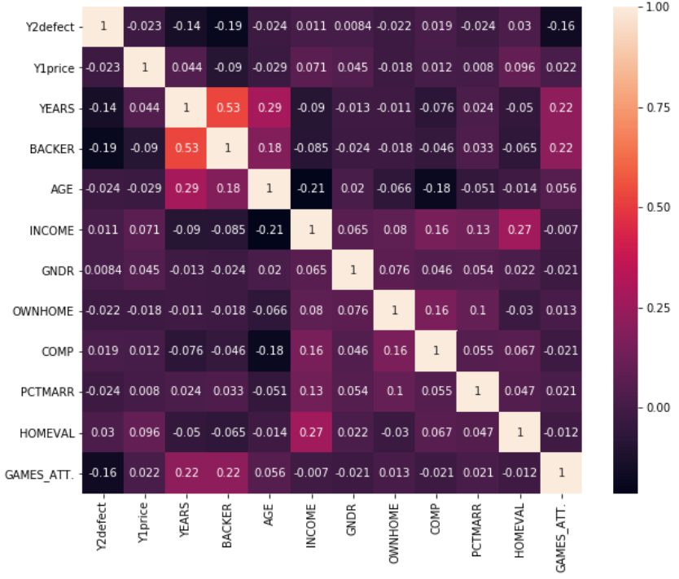
Exploratory Data Analysis
The First thing I did in Exploratory data Analysis was run a correlation test to see which variables were correlated with defectors.

Slide 6
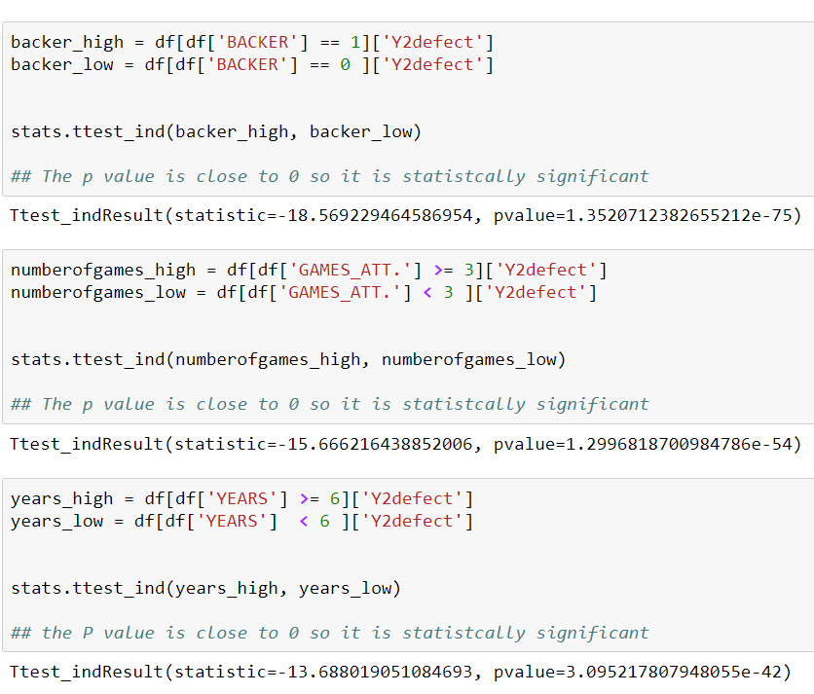
Hypothesis Testing
Here I ran some statistical tests to determine if the variables I thought were going be significant in determining whether or not someone would return. I found that backer, games attended, and years were all statistically significant.

Slide 7
Model Building
Here I ran a feature selection to determine how important the each variable really was to the if a season ticket holder was going to come back next year. I found that Homevalue, PCTMARR, and Years were the most significant.

Slide 8
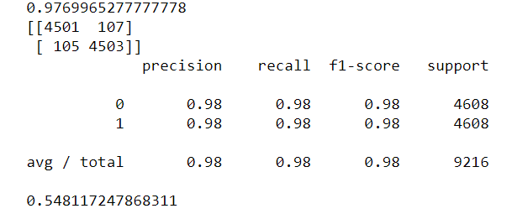
Model building
I ran many models including decision tree, KNN, Logistical regression, and random forest. Ultimately I chose random forest because of its’ high accuracy score.

Slide 9
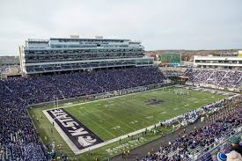
Conclusion
This information can be used in many ways one is to use the information that was returned by the model to market to those individuals who you think are going to not come back and maybe offer them discounts or deals to incentivize their continued support of the team. It could also be used to see if ticket prices are fair or evaluate the experience of the stadium. This information will provide mangers with the proper knowledge to continue to be a successful and profiting business.

